Slide 1
Brief:
The client in question is interested in finding an alternative to the hose for watering their garden plants. They are considering investing in a rain harvesting tank, however the designs currently available are not an aesthetically pleasing match for the client’s taste. Design a rainwater harvesting tank that functions appropriately to create a sustainable plant irrigation system whilst keeping the aesthetics of the product in consideration with the clients wants and needs.
Average water needed a day for plants: 20 litres
Average garden size: 140 square metres
According to building regulations, anything built underground must be less than half of the length of the garden.
Versus Table
 | Function | Aesthetics | Cost | Environmental Impact | Reliability | Quality | Weighting
Function | ----------- | 1 | 1 | 0 | 1 | 0 | 3
Aesthetics | 0 | ------------- | 1 | 0 | 0 | 0 | 1
Cost | 0 | 0 | ----- | 1 | 0 | 1 | 2
Environmental Impact | 1 | 1 | 0 | ------------------- | 1 | 0 | 3
Reliability | 0 | 1 | 1 | 0 | ------------- | 0 | 2
Quality | 1 | 1 | 0 | 1 | 1 | ---------- | 4
5W’s
Who | The client, the one who is interested in finding the alternative to the hose to water their plants.
What | Rain water harvesting tank, its purpose is to replace the hose.
When | This tank will be used during the rain to filter and process the rainwater for the users plants. The use of a
Where | We are based in London, it will be used in gardens or greenhouses. The tank will be situated in the users back garden and sizing is mainly focused on average sizes of London back gardens.
Why | The Rain Harvesting tank is used as a sustainable replacement for regular everyday hoses used in gardening. This tool aims to reduce water consumption highlighting its importance.
How | How big?: For this item, we offer standard and large sizes. Based on the needs of this client, the water tank size needed would be a standard -gallon tank. This should be able to store a weeks’ worth of irrigation water based on the size of their garden, with some extra water to spare in case rain is scarce. How long?: As excavation work is needed, the tank installation time may take up to 5 days. This may cause some disruption, but care will be taken to ensure that everything is replaced accordingly. How much?: The cost of the tank plus the filter would total around
Function: | Ensuring that the water tank concept works properly and achieves its’ expectations.
Aesthetics: | Whether or not the water tank looks appealing to the buyer.
Reliability: | This dictates whether the tank will consistently work up to standard or if, for example, the power generated by it is inconsistent.
Quality: | The materials used and if it’s been built well. For example, as a water tank it would need a material which is waterproof and will not wear down by the rain.

Slide 2
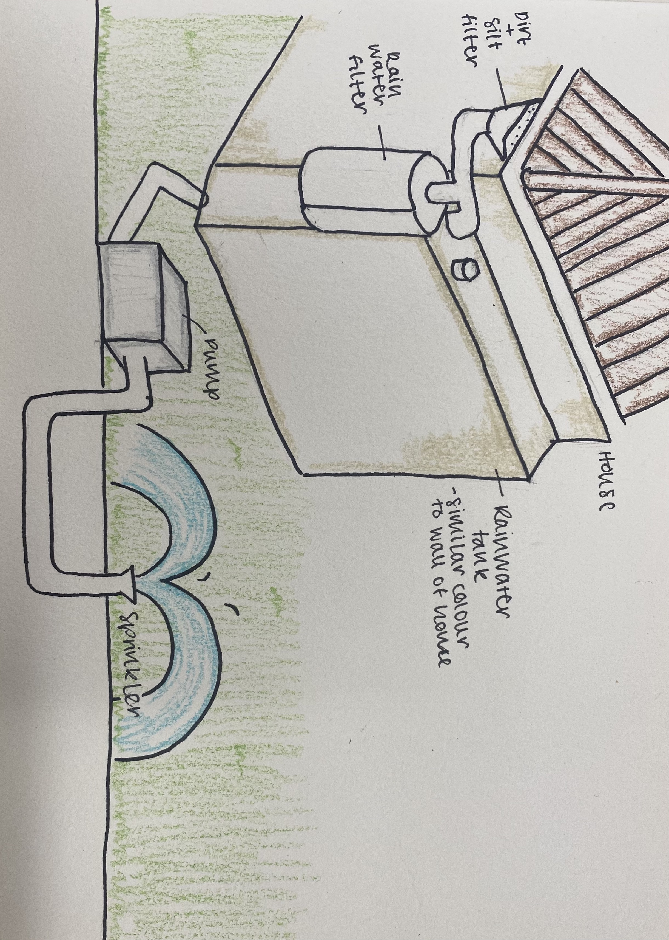
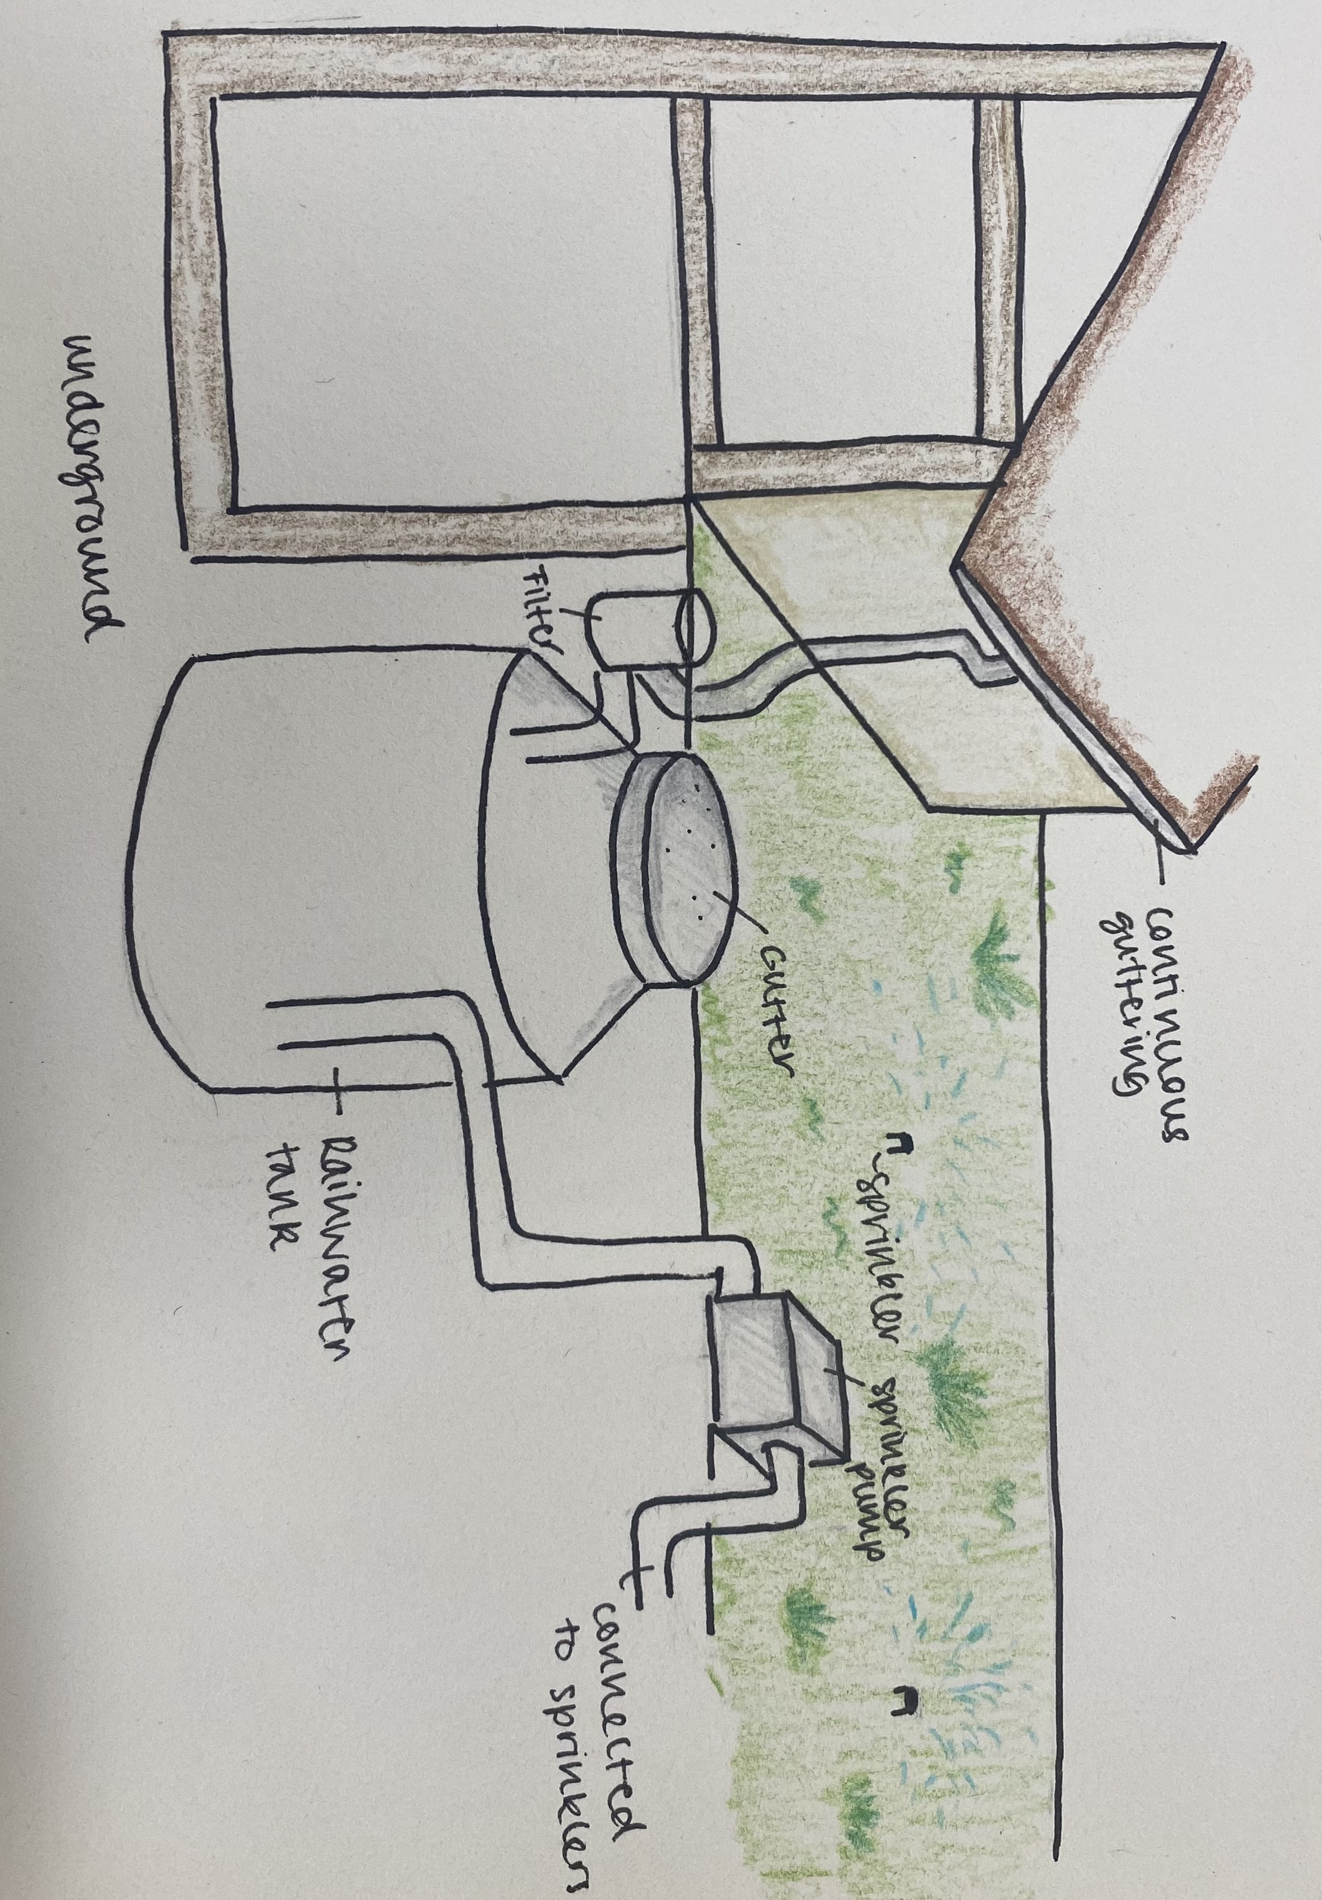
Pros and Cons:
Concept 1:
Pro’s: Aesthetics wise, it effectively blends in with the client’s wall, which adheres to their preferences. The shape of the tank is also effective in achieving this, and the gutter system works very well in ensuring that a steady flow of filtered water is transferred to the tank. The installation process is also relatively quick and straightforward, minimizing hassle for the client.
Cons: Despite the design fitting the aesthetics relatively well, there is still bulk attached to the wall which may disagree with the client. The tank and the pump also stand out.
Overall, this design matches the sustainability and functional needs of the client and has a worry free installation process which is desirable.
Concept 2:
Pros: The clients aesthetic issue has been resolved almost completely, as the large bulky tank is completely underground, with all that shows up being the gutter and the pump. This method is also better at collecting rainwater as it collects it via both the gutter and the pump, increasing intake.
Cons: The main disadvantage with this design is the installation process, as this can be significantly more costly and take longer than concept one.
Overall, this design is more sustainable than concept one and adheres best with the clients brief.
FINAL DECISION:
Based on the research done, we conclude that concept two is most appropriate for our client. As aesthetics and function are the two most important concepts here, the price can be increased if better quality is promised.
Concept one consists of a rainwater tank that has a rectangular shape instead of a traditional cylindrical one. This is mainly in order to prevent it from standing out too much and looking garish. The colour of the tank would match that of the wall, in order to further improve aesthetics. The one thing that stands out in this design is the rainwater filter, which adds a bit of bulk but not too much.
How does it work?: Rain water is collected from the gutter system near the roof. The drain has a silt and dirt filter which removes large particles from the rainwater. The rain water filter then filters out any other debris or impurities. When the plants need water and the tank is full above the minimum level, the water travels through the pipe to the pump, which is connected to any sprinkler positioned in the garden.
Installation: The tank can be manufactured off site and then transported and fitted to the clients house by professionals.
Concept two is a traditionally sized rainwater tank which is built underground. This eliminates the aesthetic issue that the client has, as the tank in question isn’t visible at all in this case. The tank is directly below a gutter which collects all the water. The gutter can be positioned close to the pipes to reduce hassle and minimise negative visual effect overall.
How does it work?: Like in concept one, water is collected from a continuous guttering system and goes through a filter. In this design however, water can also be collected via the gutter and, after a quick filtration process, it goes straight into the tank. A pump can again be connected via a pipe to this underground tank and then to the garden sprinklers.
Installation: The ground needs to be excavated to allow space for the tank, which will require a maximum of 5 days disturbance for the client.

